Slide 1
DM-GAN Baseline Reimplementation
Milestone 2 · Baseline Implementation and Investigation
From official architecture to a reproducible dynamic-memory pipeline
BASELINE
DATA
CORE
NEXT
DM-GAN
CUB
Memory
Part-aware
Initial image + memory refinement
11,788 images · 10 captions
Write · Read · Reply
Alignment improvement
Presenter: Wenzhe Cao (Jason) Group Members: Jikui Zhou, Xinyi Jiang, Zhongyu Yin
1 / 10
Notes:
[Sources]
User-provided literature-research deck: Text-to-Image Final Presentation.pptx
DM-GAN official repository: https://github.com/MinfengZhu/DM-GAN

Slide 2
01
Milestone 2: DM-GAN Baseline
Implementation · Investigation · 10-minute presentation
Assignment
Concrete Question
Choose and reimplement one baseline DM-GAN is selected as our generative baseline. Investigate baseline problems Trace environment barriers and model failure modes. Deliverable A reproducible code path, honest verification status, and a concrete improvement hypothesis.
Can we reproduce the DM-GAN pipeline on CUB and verify whether dynamic memory repairs text–image mismatches when the initial image is weak? Milestone result: modern core + official weights + real CUB backprop + 30,000-sample evaluation. Verdict: baseline reproduction passed; local from-scratch convergence remains pending.
2 / 10
Notes:
Explain that the milestone progressed beyond a code audit: the official checkpoint was executed locally, a real CUB batch completed the complete loss/backprop path, and a 200-step short run produced a saved checkpoint.
[Sources]
DM-GAN official repository: https://github.com/MinfengZhu/DM-GAN
Local integration report: /home/zjk/Desktop/DM-GANS/artifacts/session6/real_integration/report.json
Local short-run summary: /home/zjk/Desktop/DM-GANS/artifacts/session6/short_run/summary.json

Slide 3
02
Why DM-GAN Is the Right Baseline
Open implementation · clear mechanism · direct link to alignment
Why This Model
What We Reimplement
CVPR 2019 GAN baseline with open code and checkpoints Three outputs: 64×64 → 128×128 → 256×256 Dynamic memory targets missing colors and local attributes
Pretrained DAMSM sentence/word inputs Conditioning Augmentation + initial generator Writing gate · key/value read · response gate Conditional + unconditional discriminators at three scales
Reproduction target: CUB with official DAMSM inputs. A 30,000-sample official-weight evaluation passed; local from-scratch convergence remains pending.
3 / 10
Notes:
Clarify the implementation boundary: DAMSM encoders are loaded from official pretrained weights; the modern implementation covers conditioning augmentation, the initial generator, dynamic memory, three discriminators, losses, optimization, EMA, and checkpointing.
[Sources]
DM-GAN official repository: https://github.com/MinfengZhu/DM-GAN
Local implementation: /home/zjk/Desktop/DM-GANS/dmgan

Slide 4
03
DM-GAN: Initial Image → Memory Refinement
DM-GAN (Zhu et al., 2019, CVPR) — refinement driven by current image content
Core Pipeline
Key Trick: Dynamic Memory
Text + noise
→
Initial 64×64 image
→
Memory-guided 128×128 / 256×256
Problem: later stages inherit errors from a weak initial image. Solution: rebuild a word memory at each refinement stage and query it with current image features.
A sentence vector produces the first image; word features are then selected according to the current visual state and reused at both refinement scales.
Write–Read–Reply
Write: combine each word with the current image through a writing gate. Read: spatial image queries address key–value memory. Reply: a response gate controls how much memory updates each visual location. Result: 64×64 initial → 128×128 refinement → 256×256 refinement.
4 / 10
Notes:
[Sources]
Zhu et al., DM-GAN, CVPR 2019, Sections 3.1–3.3 and Figure 2
https://openaccess.thecvf.com/content_CVPR_2019/papers/Zhu_DM-GAN_Dynamic_Memory_Generative_Adversarial_Networks_for_Text-To-Image_Synthesis_CVPR_2019_paper.pdf

Slide 5
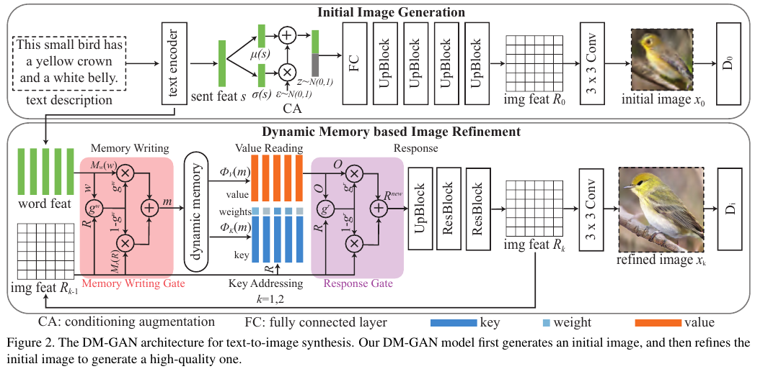
04
Reimplementation: Dynamic Memory as a Module
Modern PyTorch core following the official write–read–reply computation
Implemented Components
① Conditioning Augmentation ② Initial 64×64 generator ③ Memory writing gate ④ Key/value addressing ⑤ Response gate ⑥ 64/128/256 discriminators
Training Flow
Encode: frozen DAMSM supplies sentence and word features Generate: one initial image plus two memory-guided refinements Train: conditional GAN losses at 64/128/256 + DAMSM matching + KL
Official architecture: word memory is rewritten and queried at both refinement stages. Our code exposes attention and writing-gate tensors for diagnosis.
5 / 10
Notes:
[Sources]
Official DM-GAN Figure 2 retained from the user-provided source deck
Official model code: https://github.com/MinfengZhu/DM-GAN/blob/master/code/model.py
Local modernized core: dmgan_reimplementation/models.py

Slide 6
05
Data and Reproduction Protocol
CUB-200-2011 · DAMSM inputs · fixed three-scale evaluation
Dataset
Reproduction Steps
CUB-200-2011 11,788 images · 200 bird species 10 captions per image in DM-GAN metadata 15 part locations + 312 attributes Why CUB Fine-grained and suitable for diagnosing part–attribute errors
① Prepare official birds metadata and CUB images ② Load pretrained DAMSM text/image encoders ③ Run 64/128/256 forward and loss smoke tests ④ Train official baseline: batch 10, up to 800 epochs ⑤ Generate fixed test samples and evaluate
Evaluation
Fair comparison requires one evaluator: the repository reports different PyTorch and TensorFlow FID values.
IS ↑ · FID ↓ · R-precision ↑ · same DAMSM encoder · fixed seeds/sample count · qualitative failure taxonomy
6 / 10
Notes:
[Sources]
CUB-200-2011 official dataset: https://www.vision.caltech.edu/datasets/cub_200_2011/
Official bird configuration: https://github.com/MinfengZhu/DM-GAN/blob/master/code/cfg/bird_DMGAN.yml

Slide 7
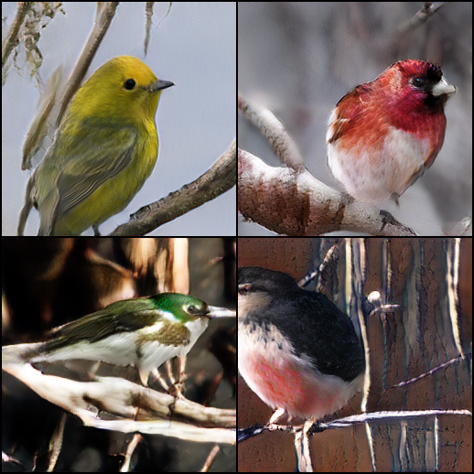
06
Baseline Reproduction: Comparable Metrics Pass
30,000 fixed CUB test samples · author weights through the modern code path
CORE · MODULES
TEST · SUITE
EVAL · SCALE
6 / 6
PASS
30,000
CA + initial + memory + 3D
7 tests · full G/D
fixed test samples
Official checkpoint · local inference
Official Pretrained Ref.
30,000 fixed samples · strict weights. FID: 15.76 vs 15.34 official. R-precision: 76.67% ±0.83 vs 76.58% ±0.53. Verdict: PASS. IS 5.70±0.09 uses ImageNet—not paper-comparable.
R-precision
76.58% ±0.53
PyTorch FID
15.34
CUB IS (legacy)
4.71 ±0.06
Paper FID
16.09
7 / 10
Notes:
Lead with the formal evidence: the author-released generator and DAMSM weights were loaded strictly and evaluated on 30,000 fixed CUB test samples through the modern code path. Comparable PyTorch FID and DAMSM R-precision both meet the predeclared pass bounds. The ImageNet Inception Score is a health check only; it is not comparable with the paper's legacy 50-class bird evaluator.
[Sources]
Formal evaluation report: /home/zjk/Desktop/DM-GANS/artifacts/session6/baseline_evaluation/report.json
Evaluation methodology: /home/zjk/Desktop/DM-GANS/artifacts/session6/baseline_evaluation/BASELINE_EVALUATION.md
DM-GAN performance table: https://github.com/MinfengZhu/DM-GAN#performance

Slide 8
07
What the Baseline Reproduction Proved
Comparable metrics validate the modern inference path—not a new training recipe
Comparable Evaluation
Interpretation Boundary
✓ 30,000 fixed CUB test samples ✓ PyTorch FID: 15.76 vs 15.34 ✓ R-precision: 76.67% vs 76.58% ✓ Strict weights + full path: PASS
Author-weight inference through the modern code path is reproduced. The 200-step random-init checkpoint remains pipeline evidence—not a converged baseline.
Baseline Verdict
PASS: comparable FID and R-precision meet predeclared bounds. ImageNet IS 5.70±0.09 is separate because the paper used a legacy bird classifier.
8 / 10
Notes:
State the claim precisely: these results validate author-weight inference through the modern implementation. They do not show that the 200-step random-initialized checkpoint is a converged model and they do not test the part-aware proposal.
[Sources]
Formal evaluation report: /home/zjk/Desktop/DM-GANS/artifacts/session6/baseline_evaluation/report.json
Baseline completion record: /home/zjk/Desktop/DM-GANS/SESSION6_COMPLETION.md

Slide 9
08
Potential Improvement: Part-Aware Memory
Use CUB annotations to align attribute words with bird parts
Model Change
Controlled Test
Use 15 annotated bird-part locations to form differentiable part heatmaps. Align attribute-word attention with head, wing, breast, belly, and tail regions. Prototype loss is implemented and unit-tested; it remains disabled in the baseline.
Baseline: official DM-GAN core Variant: + part-aware alignment loss Keep fixed: DAMSM, seeds, split, training budget Measure: FID, R-precision, part–attribute accuracy Status: ablation not yet run
Hypothesis: part-aware supervision reduces “right attribute, wrong region” errors while preserving image realism.
9 / 10
Notes:
The part-aware alignment loss is implemented as an optional, unit-tested prototype. No performance improvement is claimed because the controlled ablation has not yet been trained.
[Sources]
CUB dataset and part annotations: https://www.vision.caltech.edu/datasets/cub_200_2011/
Prototype implementation: /home/zjk/Desktop/DM-GANS/dmgan/part_aware.py
Prototype test: /home/zjk/Desktop/DM-GANS/tests/test_part_aware.py

Slide 10
09
Next Week: Part-Aware Ablation
Baseline validated; improvement efficacy is the next controlled question
Completed
Experiment Plan
1. Strict official checkpoint load 2. 30,000 fixed CUB samples 3. FID 15.76 (reference 15.34) 4. R-precision 76.67% (ref. 76.58%) 5. Baseline verdict: PASS
① Freeze the evaluation protocol ② Train equal-budget baseline/variant ③ Track part-attribute accuracy ④ Compare R-precision and FID ⑤ Report trade-offs, not just wins
Success Criteria
This week: baseline reproduction passed. Next week: test whether part-aware alignment improves it.
One evaluator · higher R-precision/part accuracy · no material FID regression
10 / 10
Notes:
Close with the decision boundary. This week answers whether the baseline reproduction is reasonable: yes, on comparable FID and R-precision. Next week is a separate equal-budget experiment to determine whether part-aware alignment improves the baseline without materially worsening FID.
[Sources]
Formal evaluation report: /home/zjk/Desktop/DM-GANS/artifacts/session6/baseline_evaluation/report.json
Session 6 checklist: /home/zjk/Desktop/DM-GANS/docs/session6_checklist.md

